Slide 1


K.RAMAKRISHNAN COLLEGE OF TECHNOLOGY
(AUTONOMOUS), TRICHY.
DEPARTMENT OF
COMPUTER SCIENCE AND ENGINEERING
20CS5501 DESIGN PROJECT-1
Batch No. : 05
Date : 05.12.2024

Slide 2
Title of the Project
HostelXpert Your Smart Companion for Seamless Hostel Management
Guided by Team
Mr. A. Malarmannan, M.E., Abirami R (811721104006)
Assistant Professor, CSE Durgasri V (811721104036)
Jasmine M (811721104061)

Slide 3
OBJECTIVE OF THE PROJECT
The Hostel Management System is designed to streamline and automate various aspects of hostel operations.
The primary objective of the system is to provide a user-friendly platform for students, administrators, and hostel authorities to interact and manage hostel-related activities.
By automating tasks such as room allocation, outpass management, and feedback collection, the system aims to improve communication, enhance student satisfaction, increase transparency, and reduce administrative workload.

Slide 4
ABSTRACT
The HostelXpert Your Smart Companion for Seamless Hostel Management
is a web-based solution designed to streamline and enhance hostel operations. This system provides a user-friendly platform for managing various hostel activities, including room allocation, outpass application, feedback submission, ratings, and complaint management. By replacing traditional manual methods, the system ensures efficient data management, reduces human errors, and enhances user experience. The platform enables students to easily apply for outpasses, submit feedback, and lodge complaints, while administrators can manage room assignments and track user activities seamlessly. This system aims to improve operational efficiency and foster a transparent and organized hostel environment.

Slide 5
LITERATURE SURVEY
TITLE OF THE PAPER | AUTHOR (S) | PUBLISHER | PAPER GIST | TECHNOLOGY USED
Design and Implementation of Hostel Management | Jane smith et al | Journal of Emerging Technologies and Innovative Research (JETIR) | replace manual registration processes, addressing issues like data redundancy, recovery challenges, and inefficiencies. | HTML, CSS, and JavaScript for front-end design. Node.js and Express.js for backend. MongoDB as the database.
Enhancing hostel management through technology integrations | Emily brown | International Journal for Research in Applied Science and Engineering Technology (IJRASET). | The paper introduces a conceptual framework for "Smart Hostels," integrating advanced technologies to solve common challenges in hostel management. | Internet of Things (IoT)
A comparative study of hostel management system | Michael johnson | International Journal of Research and Analytical Reviews (IJRAR) and the International Journal of Research Publication and Reviews (IJRPR). | This study explores various hostel management systems and compares existing and proposed technologies | PHP, ASP.NET, SQL Server, and MySQL for backend integration.
Development of automated hostel facility management system | ayanlowo | Journal of Science and Engineering (ORIC Publications). | The paper outlines the creation of an automated hostel management system designed to replace manual methods of managing hostel facilities. | Visual Basic (VB), Microsoft Access.
Smart dashboard for hostel activities | Akshara singh | International Journal of Advances in Engineering and Management (IJAEM) | This paper proposes a "Smart Dashboard" for effectively managing hostel activities by automating routine administrative tasks. | Frontend: HTML, CSS Backend: JavaScript frameworks

Slide 6
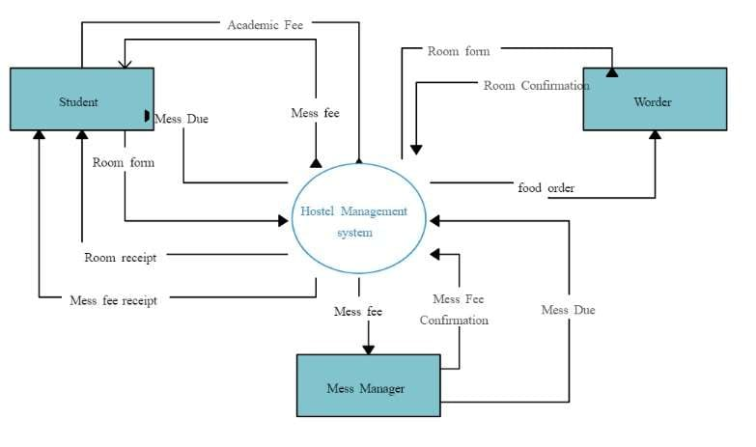
PROPOSED SYSTEM ARCHITECTURE

Slide 7
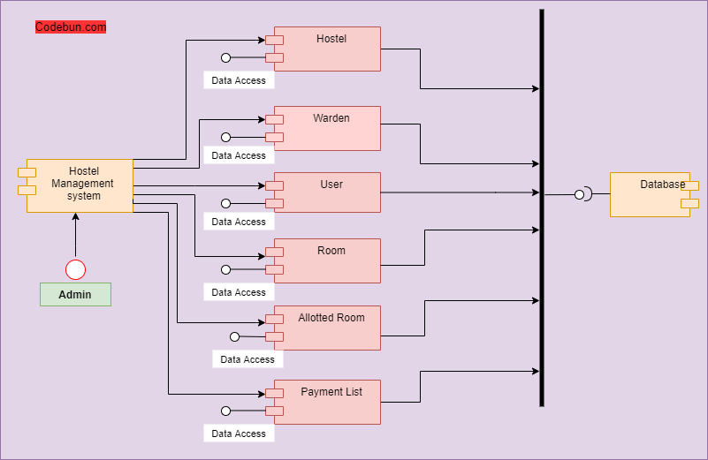
EXISTING SYSTEM ARCHITECTURE

Slide 8
SOFTWARE AND HARDWARE REQUIREMENTS
HARDWARE
SOFTWARE
Processor: Intel i5 or AMD Ryzen 5 and above.
Processor: Intel i5 or AMD Ryzen 5 and above.
Display: 1366x768 resolution (Full HD recommended).
Network: Stable internet connection.
Operating System: Windows 11.
Code Editor: Visual Studio Code.
Database: MySQL (via XAMPP).
Web Server: Apache (via XAMPP).
Programming Languages: PHP, JavaScript, HTML, CSS.

Slide 9
MODULES
User Login
Feedback
Outpass Management
Room Allocation
Messages

Slide 10
SUMMARY OF MODULE-1
USER LOGIN:
User registration with email/phone verification.
Secure login with password encryption.
Role-based access (Admin, Student, Staff).
Profile management (edit/update details).
Password recovery and reset options.

Slide 11
SUMMARY OF MODULE-2
FEEDBACK:
Submit feedback for services (e.g., food, maintenance).
Anonymous feedback option.
Feedback rating system (1-5 stars).
Admin view and response to feedback.
Reports and analytics for feedback trends.

Slide 12
SUMMARY OF MODULE-3
OUTPASS:
Leave application submission with date and reason.
Approval/rejection system for admins/staff.
Notification for leave status updates.
Leave history tracking for users.
Automated reminders for return dates.

Slide 13
SUMMARY OF MODULE-4
ROOM ALLOCATION:
Room availability display.
Student allocation to specific rooms.
Room change request and approval.
Maintenance status tracking per room.
Room capacity and occupancy reports.

Slide 14
SUMMARY OF MODULE-5
MESSAGES:
Admin-to-user and user-to-admin messaging.
Group messages for announcements.
Notifications for unread messages.
Chat history storage and retrieval.
Integration with email/SMS for important updates.

Slide 15
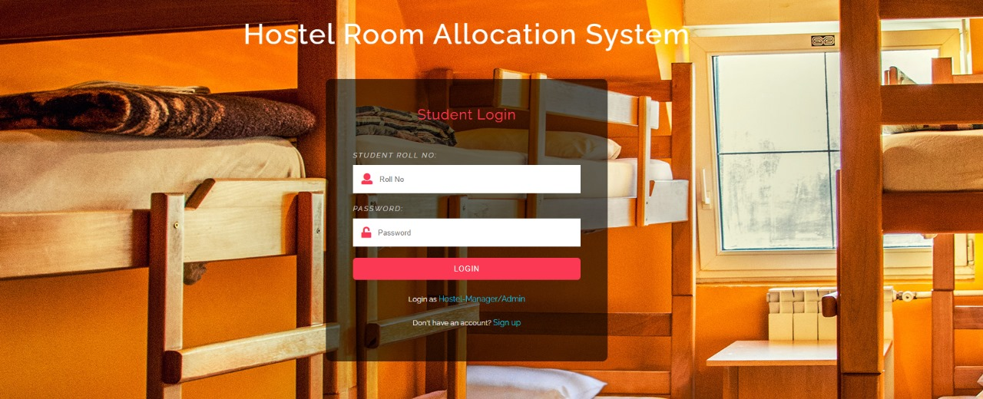
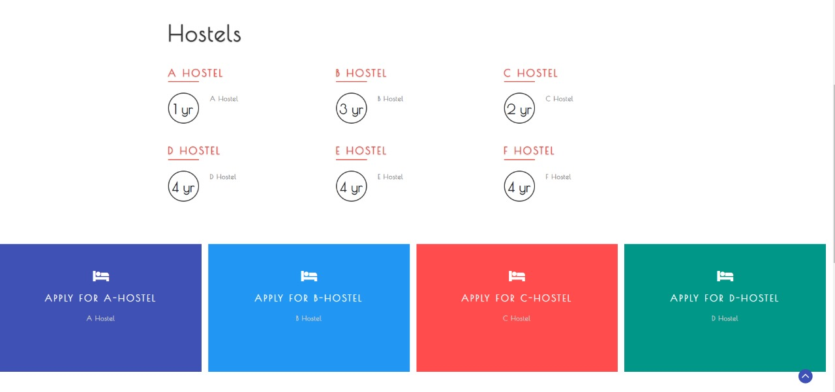
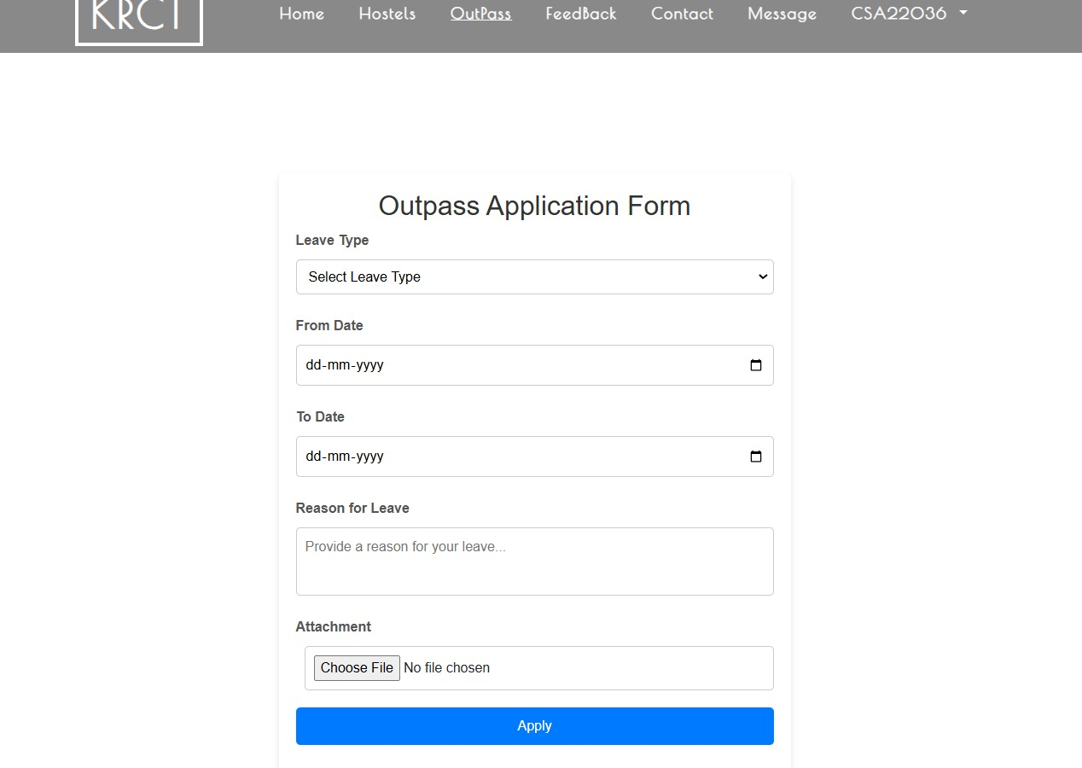
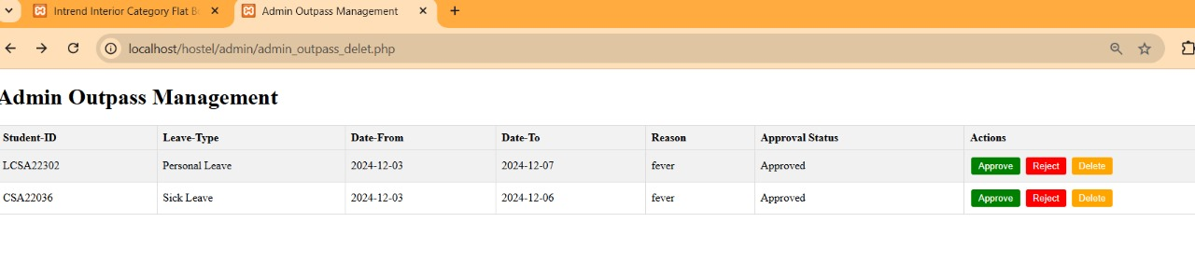
RESULTS AND DISCUSSION

Slide 16
Students can provide feedback on hostel services, allowing administrators to identify areas for improvement.
Students can apply for outpasses, which can be approved or rejected by administrators.
Students and administrators can log in to the system to access various features and functionalities.
The system automates room allocation, ensuring that students are assigned rooms efficiently.
Administrators can send messages to students, keeping them informed about important hostel-related updates.
Students can apply for leaves, which can be approved or rejected by administrators.

Slide 17
CONCLUSION
The system automates various hostel-related activities, making it easier to manage.
The system provides a platform for students, administrators, and hostel authorities to interact and communicate.
By efficiently managing hostel services, the system improves student satisfaction and overall quality of life.
Automation of hostel operations reduces administrative workload, allowing staff to focus on other important tasks.
The system provides valuable insights into hostel operations, enabling administrators to make informed decisions.

Slide 18
THANK YOU

